Slide 1
Computer Science
Mr. Eddie

Slide 2
Do Now

Slide 3

Do Now
Answer the posted questions in
What are some differences and/or similarities between the images?
Which image do you prefer, and why? (2-3 Sentences)

Slide 4
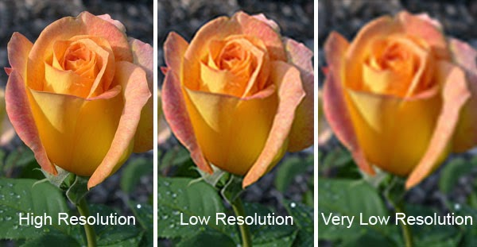

Slide 5
Agenda

Slide 6


Agenda
Ciao
Do Now
Google Classroom
Objectives
Intro to CSS
Demo
Activity
Exit Ticket
Addio

Slide 7
Unit 1
My First Website - Portfolio Check-In

Slide 8
Objectives
Images & styling with CSS
Web Lab
Feedback
Portfolio Submission

Slide 9
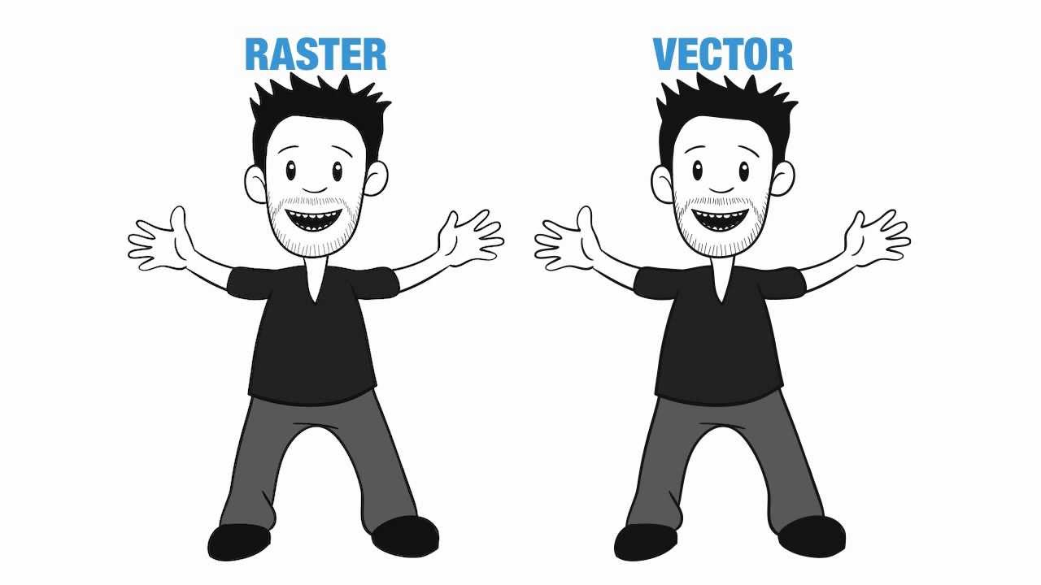
2 Types of Image files

Slide 10
Vector Images
Vector images are far more flexible. They are constructed using proportional formulas rather than pixels. EPS, AI and PDF are perfect for creating graphics that require frequent resizing. Your logo and brand graphics should have been created as a vector, and you should always have a master file on hand. The real beauty of vectors lies in their ability to be sized as small as a postage stamp, or large enough to fit on an 18-wheeler!

Slide 11
Raster Images
Raster images are constructed by a series of pixels, or individual blocks, to form an image. JPEG, GIF, and PNG are all raster image extensions. Every photo you find online or in print is a raster image. Pixels have a defined proportion based on their resolution (high or low), and when the pixels are stretched to fill space they were not originally intended to fit, they become distorted, resulting in blurry or unclear images.
In order to retain pixel quality, you cannot resize raster images without compromising their resolution.

Slide 12


 | JPEG (or JPG) - Joint Photographic Experts Group JPEGs might be the most common file type you run across on the web, and more than likely the kind of image that is in your company's MS Word version of its letterhead. JPEGs are known for their "lossy" compression, meaning that the quality of the image decreases as the file size decreases. You can use JPEGs for projects on the web, in Microsoft Office documents, or for projects that require printing at a high resolution. Paying attention to the resolution and file size with JPEGs is essential in order to produce a nice looking project.
 | PNG - Portable Network Graphics PNGs are amazing for interactive documents such as web pages, but are not suitable for print. While PNGs are "lossless," meaning you can edit them and not lose quality, they are still low resolution. The reason PNGs are used in most web projects is that you can save your image with more colors on a transparent background. This makes for a much sharper, web-quality image.

Slide 13


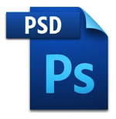
 | GIF - Graphics Interchange Format GIFs are most common in their animated form, which are all the rage on Tumblr pages and in banner ads. It seems like every other day we have a new Grumpy Cat or Honey Boo Boo animated GIF. In their more basic form, GIFs are formed from up to 256 colors in the RGB colorspace. Due to the limited number of colors, the file size is drastically reduced. This is a common file type for web projects where an image needs to load very quickly, as opposed to one that needs to retain a higher level of quality.
 | PDF - Portable Document Format PDFs were invented by Adobe with the goal of capturing and reviewing rich information from any application, on any computer, with anyone, anywhere. I'd say they've been pretty successful so far. If a designer saves your vector logo in PDF format, you can view it without any design editing software (as long as you have downloaded the free Acrobat Reader software), and they have the ability to use this file to make further manipulations. This is by far the best universal tool for sharing graphics.
 | PSD - Photoshop Document PSDs are files that are created and saved in Adobe Photoshop, the most popular graphics editing software ever. This type of file contains "layers" that make modifying the image much easier to handle. This is also the program that generates the raster file types mentioned above. The largest disadvantage to PSDs is that Photoshop works with raster images as opposed to vector images.

Slide 14
Live Demo

Slide 15
Work Time

Slide 16
Exit Ticket
Submit the link to your Website via Google Classroom

Slide 17
Addio
[Good-Bye in Italian]

Slide 18
Edwin
Home
About Me
Resume

